Slide 1

8th Grade Math: Pre-Algebra
Unit 4, Lesson 7 Applying Exponent Laws to Algebraic Expressions – Part 1 Volume 1, pg. 152

Slide 2


Benchmark
MA.8.AR.1.1
Apply the Laws of Exponents to generate equivalent algebraic expressions, limited to integer exponents and monomial bases.
volume 1, pg. 152

Slide 3
Integrated Mathematical Thinking and Reasoning Standards
MA.K12.MTR.2.1 Demonstrate understanding by representing problems in multiple ways.
MA.K12.MTR.3.1 Complete tasks with mathematical fluency.
volume 1, pg. 152

Slide 4

Learning Target
I can write an equivalent algebraic expression by applying the product of powers, power of a power, or power of a product laws of exponents.
volume 1, pg. 152

Slide 5

Warm-Up
volume 1, pg. 153

Slide 6
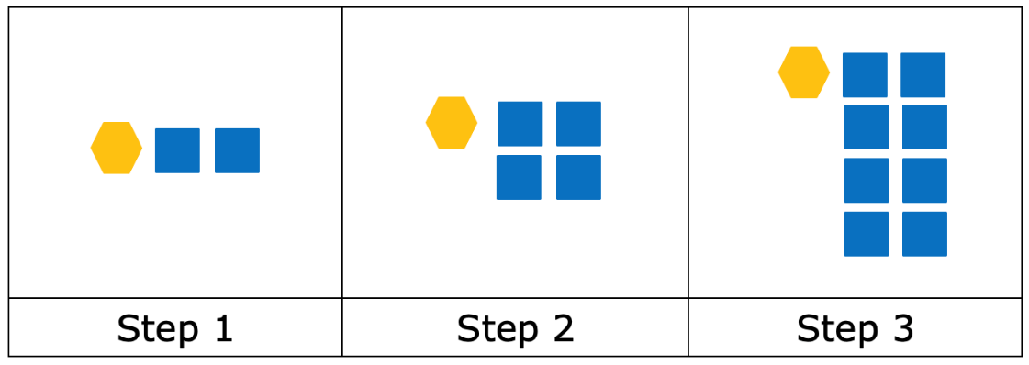
4.7.1 Warm-Up: Patterns
The first three steps in a pattern are shown in the table. The pattern is created using yellow hexagons and blue squares.
volume 1, pg. 153
Notes:
Video Link: https://algebranation.wistia.com/medias/fi4fidi5y8

Slide 7
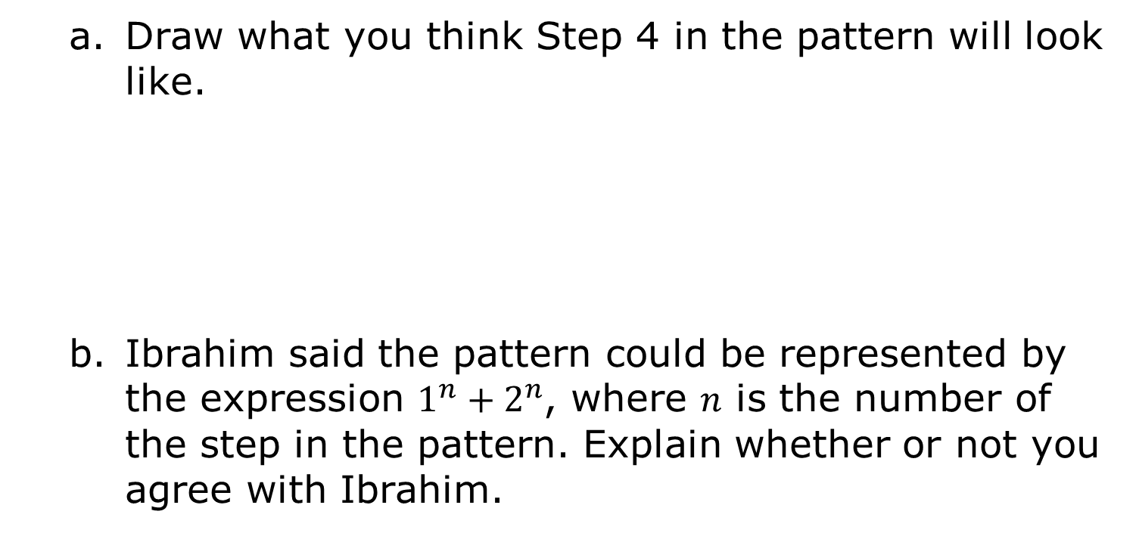
Draw what you think Step 4 in the pattern will look like.
Ibrahim said the pattern could be represented by the expression $1^{n}+2^{n}$, where 𝑛 is the number of the step in the pattern. Explain whether or not you agree with Ibrahim.
volume 1, pg. 153
Notes:
Video Link: https://algebranation.wistia.com/medias/fi4fidi5y8

Slide 8

Guided Instruction
volume 1, pg. 153

Slide 9
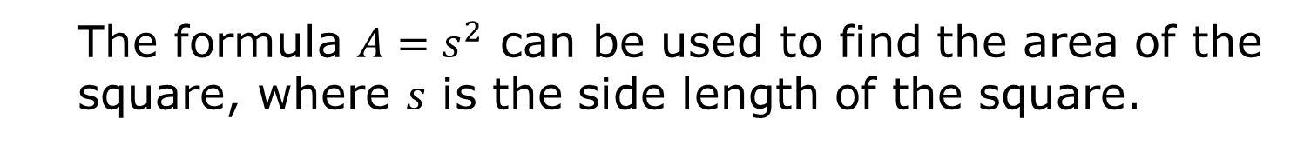

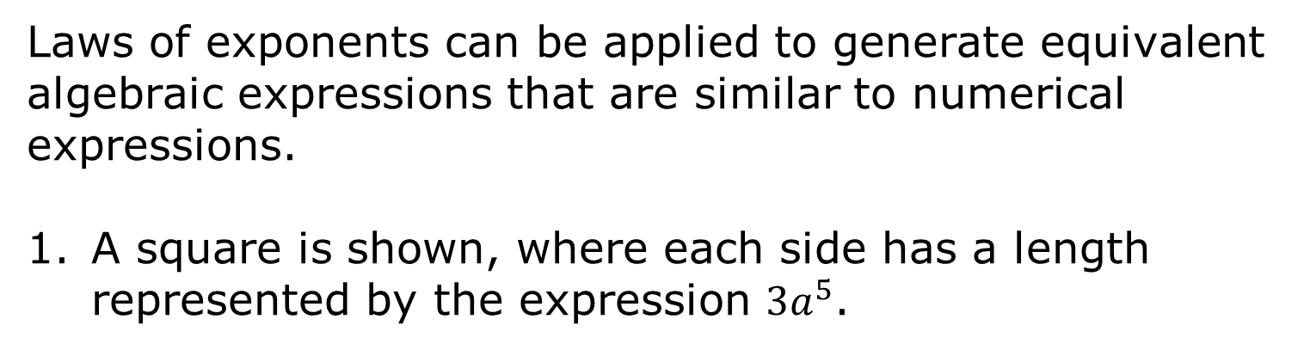
4.7.2 Guided Instruction: Equivalent Algebraic Expressions
Laws of exponents can be applied to generate equivalent algebraic expressions that are similar to numerical expressions.
A square is shown, where each side has a length represented by the expression $3a^{5}$.
$$3a^{5}$$
The formula $A=s^{2}$ can be used to find the area of the square, where 𝑠 is the side length of the square.
volume 1, pg. 153

Slide 10
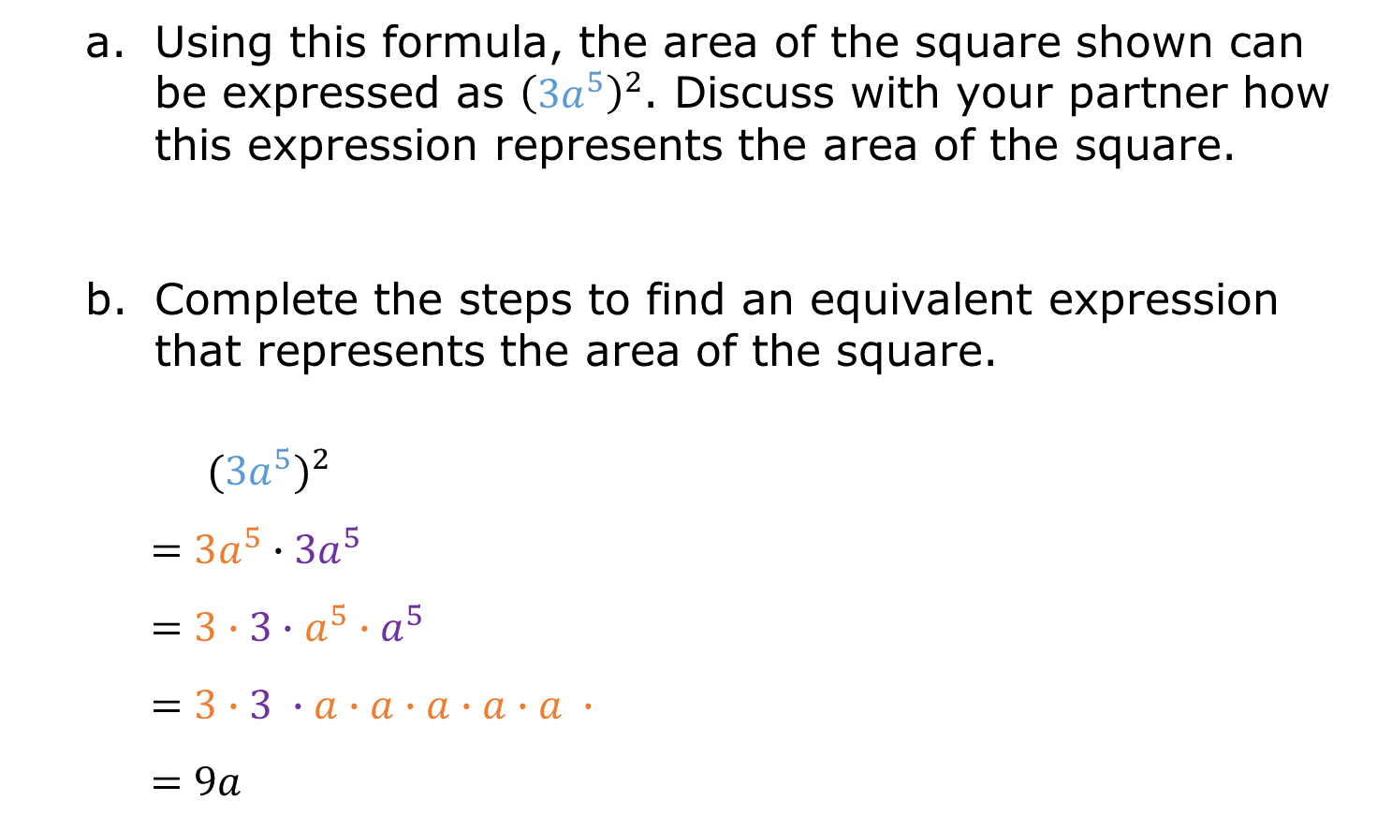
Using this formula, the area of the square shown can be expressed as ${\left({3a}^{5}\right)}^{2}$. Discuss with your partner how this expression represents the area of the square.
Complete the steps to find an equivalent expression that represents the area of the square.
$${(3a^{5})}^{2}$$
$$=3a^{5}∙3a^{5}$$
$$=3∙3∙a^{5}∙a^{5}$$
$$=3∙3 ∙a∙a∙a∙a∙a ∙$$
$$=9a$$
volume 1, pg. 153

Slide 11
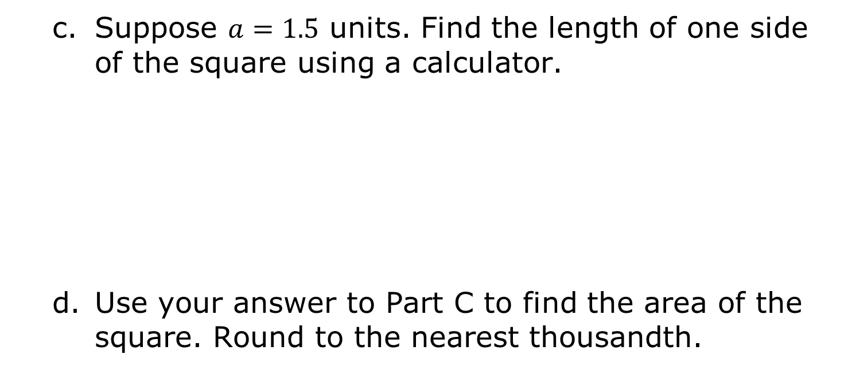
Suppose $a=1.5$ units. Find the length of one side of the square using a calculator.
Use your answer to Part C to find the area of the square. Round to the nearest thousandth.
volume 1, pg. 154

Slide 12
Use the expression generated in Part B to find the area of the square. Round to the nearest thousandth.
What do you notice?
volume 1, pg. 154

Slide 13

Exploration
volume 1, pg. 154

Slide 14

4.7.3 Exploration: Laws of Exponents with Algebraic Expressions
Several algebraic expressions are given in the table.
For each expression, work with your partner to rewrite the expression in expanded form. Then, write an equivalent algebraic expression with one variable base and one coefficient. The first row has been partially completed.
volume 1, pg. 154

Slide 15
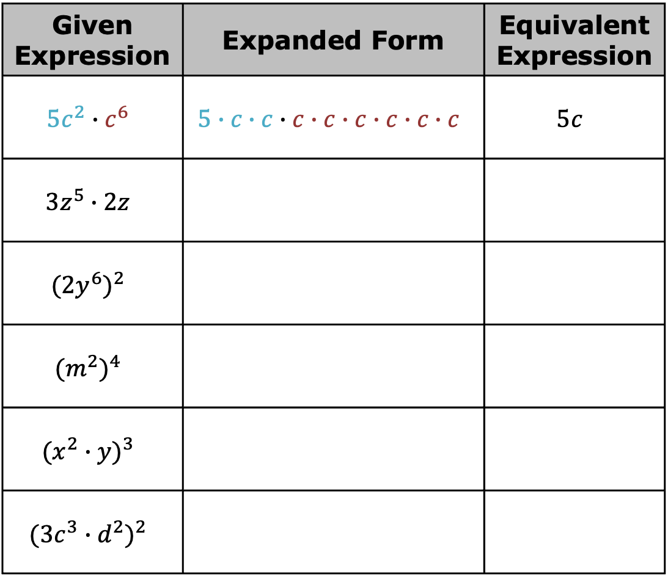
Given Expression | Expanded Form | Equivalent Expression
$${5c}^{2}∙c^{6}$$ | $$5∙c∙c∙c∙c∙c∙c∙c∙c$$ | $$5c$$
$${3z}^{5}∙2z$$
$${(2y^{6})}^{2}$$
$${(m^{2})}^{4}$$
$${(x^{2}∙y)}^{3}$$
$${(3c^{3}∙d^{2})}^{2}$$
volume 1, pg. 154

Slide 16
Discuss with your partner what you notice about how the coefficients and variable powers of the equivalent expressions compare to the given expressions.
volume 1, pg. 154

Slide 17
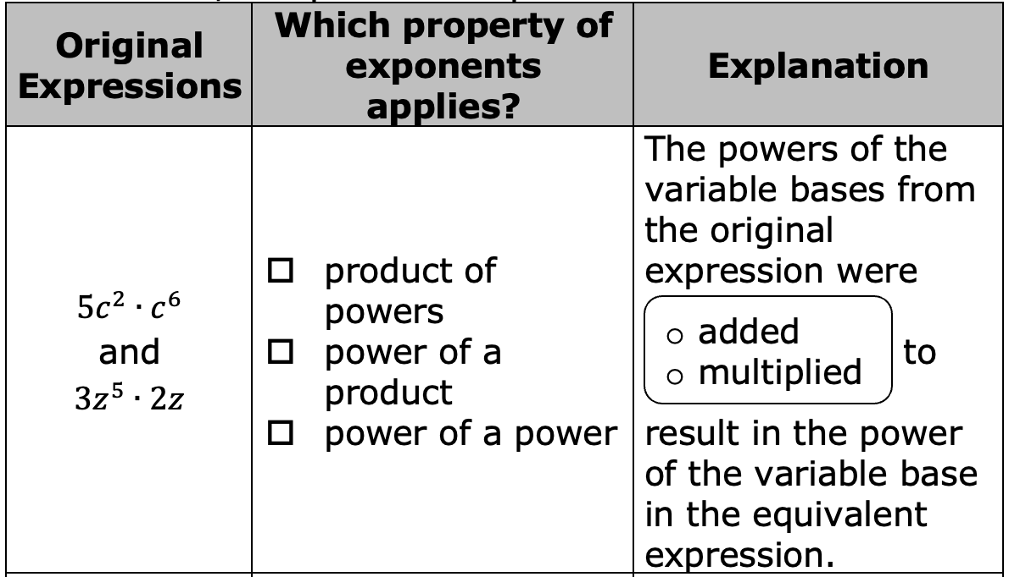
Gavin said properties of exponents could be applied to the original expressions to generate the same equivalent expression. Match each pair of expressions with the exponent law that applies. Then, complete the explanations.
volume 1, pg. 155

Slide 18
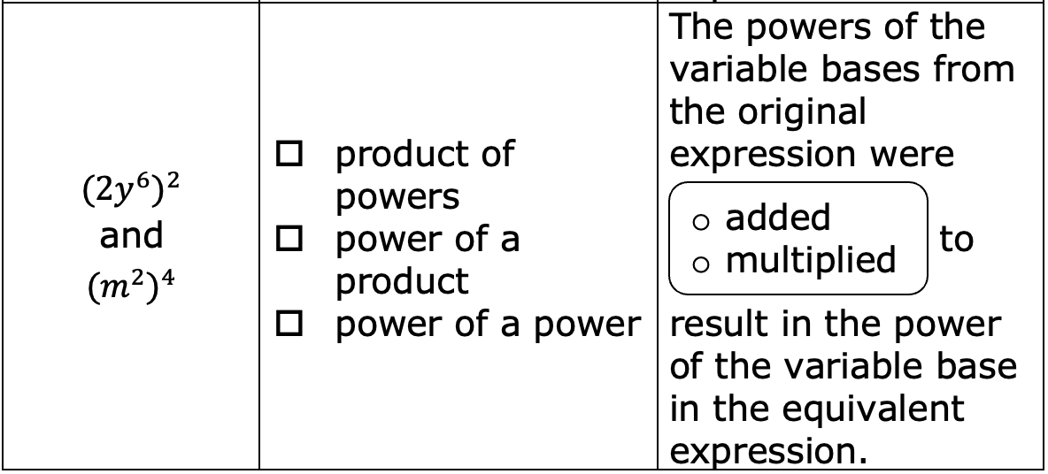
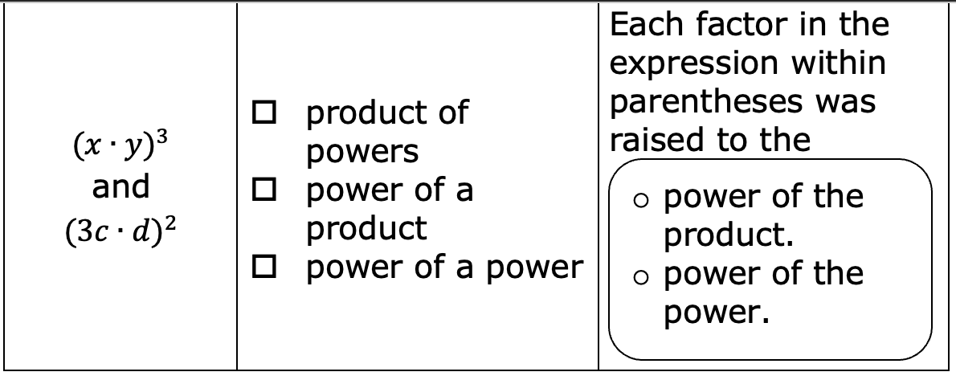
volume 1, pg. 155

Slide 19
Use words from the bank to complete the explanations of how the laws of exponents applied to the coefficients when generating the equivalent expressions.
multiplied | power | product | same
In the expressions where product of powers law applied to the variable factors, the coefficients were
________________ to find the coefficient of the ________________.
In the expressions where the power of a power law
applied, the coefficient was also raised to the power of the ________________.
In the expressions where the power of a product law applied, the coefficients of the factors were also raised to the ________________ power.
volume 1, pg. 155

Slide 20

Bring It Together
volume 1, pg. 156

Slide 21

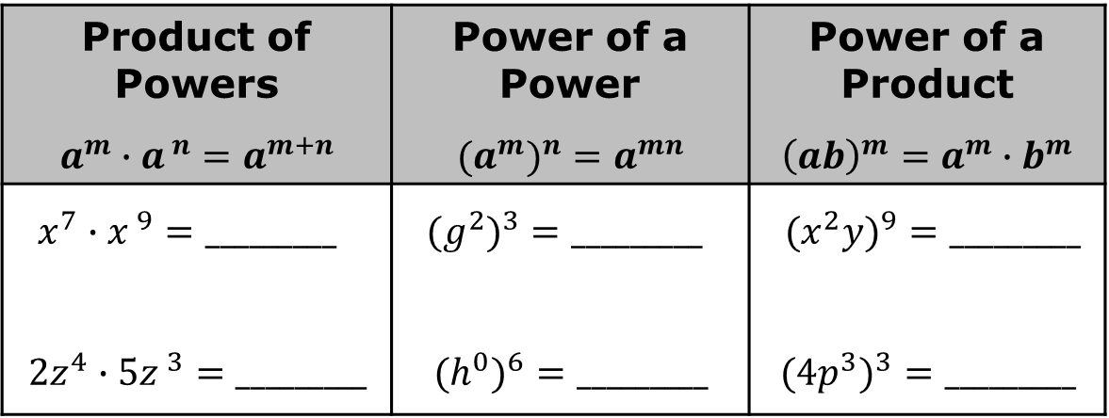
4.7.4 Bring It Together: Applying Laws of Exponents to Variables
The product of powers, power of a power, and power of a product laws of exponents apply to both variable and numerical bases when generating equivalent algebraic expressions.
Apply the law of exponents to generate equivalent expressions.
Product of Powers $$a^{m}∙a^{ n}=a^{m+n}$$ | Power of a Power $${{(a}^{m})}^{n}=a^{mn}$$ | Power of a Product $${\left(ab\right)}^{m}=a^{m}∙b^{m}$$
$x^{7}∙x^{ 9}=_________$ $${2z}^{4}∙5z^{ 3}=_________$$ | ${{(g}^{2})}^{3}=_________$ $${{(h}^{0})}^{6}=_________$$ | ${{(x}^{2}y)}^{9}=_________$ $${{(4p}^{3})}^{3}=_________$$
volume 1, pg. 156

Slide 22

Activity
volume 1, pg. 156

Slide 23


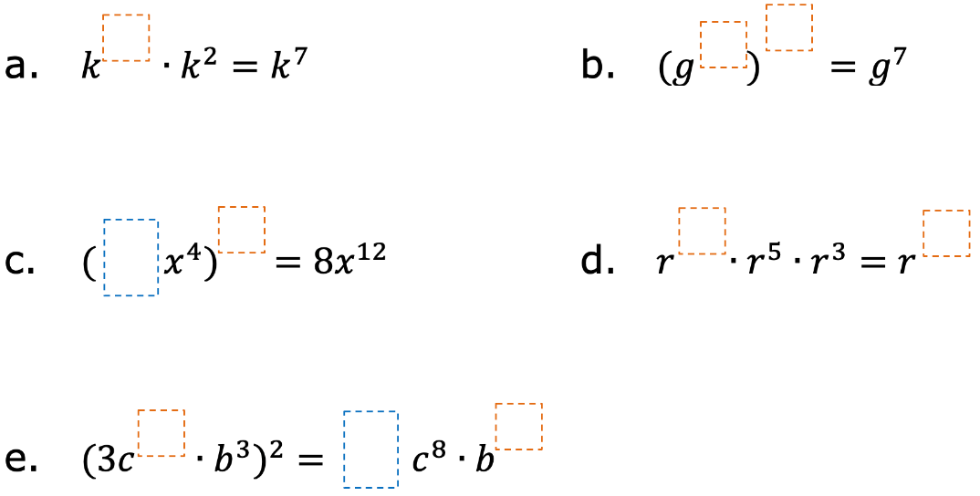
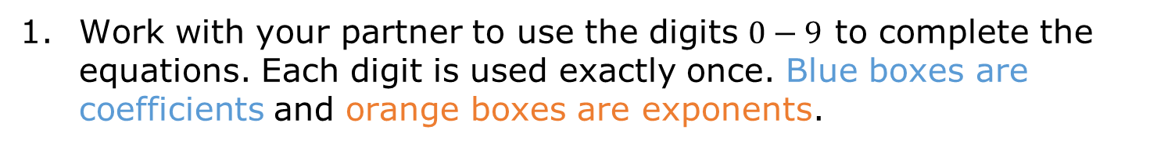
4.7.5 Activity: Missing Numbers
Work with your partner to use the digits $0−9$ to complete the equations. Each digit is used exactly once. Blue boxes are coefficients and orange boxes are exponents.
volume 1, pg. 156

Slide 24

Wrap-Up
volume 1, pg. 157

Slide 25

4.7.6 Wrap-Up: Ticket Out the Door
Apply the laws of exponents to generate an equivalent algebraic expression for each of the following.
${\left(5y\right)}^{2}=_____________$
$x^{6}·x^{3}=_____________$
${\left(t^{5}\right)}^{2}=_____________$
volume 1, pg. 157

